Slide 1
Google Play Store: App Permission Analytics
Prajit Kumar Das
Advised by: Dr. Anupam Joshi

Slide 2
Data collection stats
According to AppBrain
Current number of Android apps in the market: 1,596,584
54 App categories including Medical and Health & Fitness
46874 Health & Fitness Apps and 23824 Medical Apps
App data collected
Total app data collected: 1,431,736
42958 Health & Fitness Apps and 21033 Medical Apps
Does not reflect app permission info
Total number of apps whose permissions have been collected: 106,979
2620 Health & Fitness Apps and 758 Medical Apps

Slide 3
A bit more stats
Number of apps requesting permission | Permission Name
13484 | android.permission.INTERNET
11198 | android.permission.ACCESS_NETWORK_STATE
8393 | android.permission.READ_EXTERNAL_STORAGE
8367 | android.permission.WRITE_EXTERNAL_STORAGE
4477 | android.permission.READ_PHONE_STATE
4191 | android.permission.ACCESS_FINE_LOCATION
4164 | com.google.android.c2dm.permission.RECEIVE
4036 | android.permission.GET_ACCOUNTS
3930 | android.permission.WAKE_LOCK
3821 | android.permission.ACCESS_COARSE_LOCATION
3694 | android.permission.VIBRATE
2765 | android.permission.ACCESS_WIFI_STATE
2688 | android.permission.CAMERA
2436 | android.permission.CALL_PHONE
1551 | android.permission.RECEIVE_BOOT_COMPLETED
1545 | android.permission.RECORD_AUDIO
13484 | android.permission.INTERNET
11198 | android.permission.ACCESS_NETWORK_STATE
8393 | android.permission.READ_EXTERNAL_STORAGE
8367 | android.permission.WRITE_EXTERNAL_STORAGE
Apps request
235,869 unique permissions, top 20 requested permissions are shown below

Slide 4
A bit more stats
Number of apps requesting permission | Permission Name
13484 | android.permission.INTERNET
11198 | android.permission.ACCESS_NETWORK_STATE
8393 | android.permission.READ_EXTERNAL_STORAGE
8367 | android.permission.WRITE_EXTERNAL_STORAGE
4477 | android.permission.READ_PHONE_STATE
4191 | android.permission.ACCESS_FINE_LOCATION
4164 | com.google.android.c2dm.permission.RECEIVE
4036 | android.permission.GET_ACCOUNTS
3930 | android.permission.WAKE_LOCK
3821 | android.permission.ACCESS_COARSE_LOCATION
3694 | android.permission.VIBRATE
2765 | android.permission.ACCESS_WIFI_STATE
2688 | android.permission.CAMERA
2436 | android.permission.CALL_PHONE
1551 | android.permission.RECEIVE_BOOT_COMPLETED
1545 | android.permission.RECORD_AUDIO
13484 | android.permission.INTERNET
11198 | android.permission.ACCESS_NETWORK_STATE
8393 | android.permission.READ_EXTERNAL_STORAGE
8367 | android.permission.WRITE_EXTERNAL_STORAGE
Medical Apps request
235,869 unique permissions, top 20 requested permissions are shown below

Slide 5
A bit more stats
Health and Fitness Apps request
733 unique permissions, top 20 requested permissions are shown below
Number of apps requesting permission | Permission Name
2501 | android.permission.INTERNET
2204 | android.permission.ACCESS_NETWORK_STATE
1413 | android.permission.WRITE_EXTERNAL_STORAGE
1404 | android.permission.READ_EXTERNAL_STORAGE
816 | android.permission.WAKE_LOCK
715 | android.permission.READ_PHONE_STATE
618 | android.permission.VIBRATE
577 | android.permission.ACCESS_WIFI_STATE
575 | android.permission.ACCESS_FINE_LOCATION
516 | android.permission.ACCESS_COARSE_LOCATION
498 | android.permission.GET_ACCOUNTS
445 | com.google.android.c2dm.permission.RECEIVE
362 | android.permission.RECEIVE_BOOT_COMPLETED
322 | com.android.vending.BILLING
285 | android.permission.CAMERA
173 | android.permission.RECORD_AUDIO
150 | com.android.vending.CHECK_LICENSE
140 | android.permission.GET_TASKS
139 | com.google.android.providers.gsf.permission.READ_GSERVICES
122 | android.permission.SYSTEM_ALERT_WINDOW

Slide 6
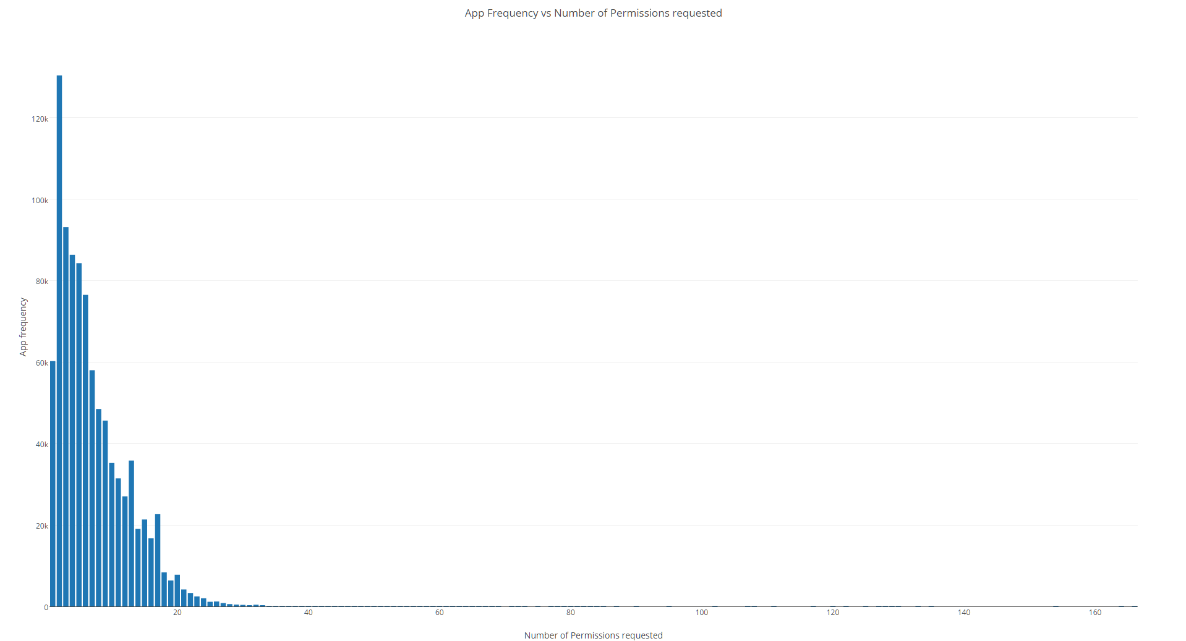
App frequency vs Permissions requested
App Package Name | Permissions Count
com.blinkbuddies.musicalbabymobile | 166
com.marthogames.muffinbutton | 164
com.jakkarrlgames.mathguru | 164
com.marthogames.starlander | 164
com.fuengfahsoft.grabtiles | 164
com.mwm.theball | 164
com.brainandheart.brainheart | 164
com.flyingcat.retroracing | 164
com.mwm.thequest | 164
com.cloudgames.snake2d | 164
com.jtwtw.god | 154
com.posstream.Monitor | 135
com.mls.updater | 133
com.luiseduardohd.nid.miqueridosanta | 130
com.team.angryballs | 129
com.team.halloweenslicer | 128
com.aqh.medways | 127
jp.ryosuke.matsuuchi.testpermissions | 127
com.webkey | 125
com.cloudshell | 125
com.eurotronik.inurse | 125
com.suspectsregistry.realbox | 122
net.altnetwork.accountability | 122
youten.redo.allpermission | 120
com.teco | 120

Slide 7
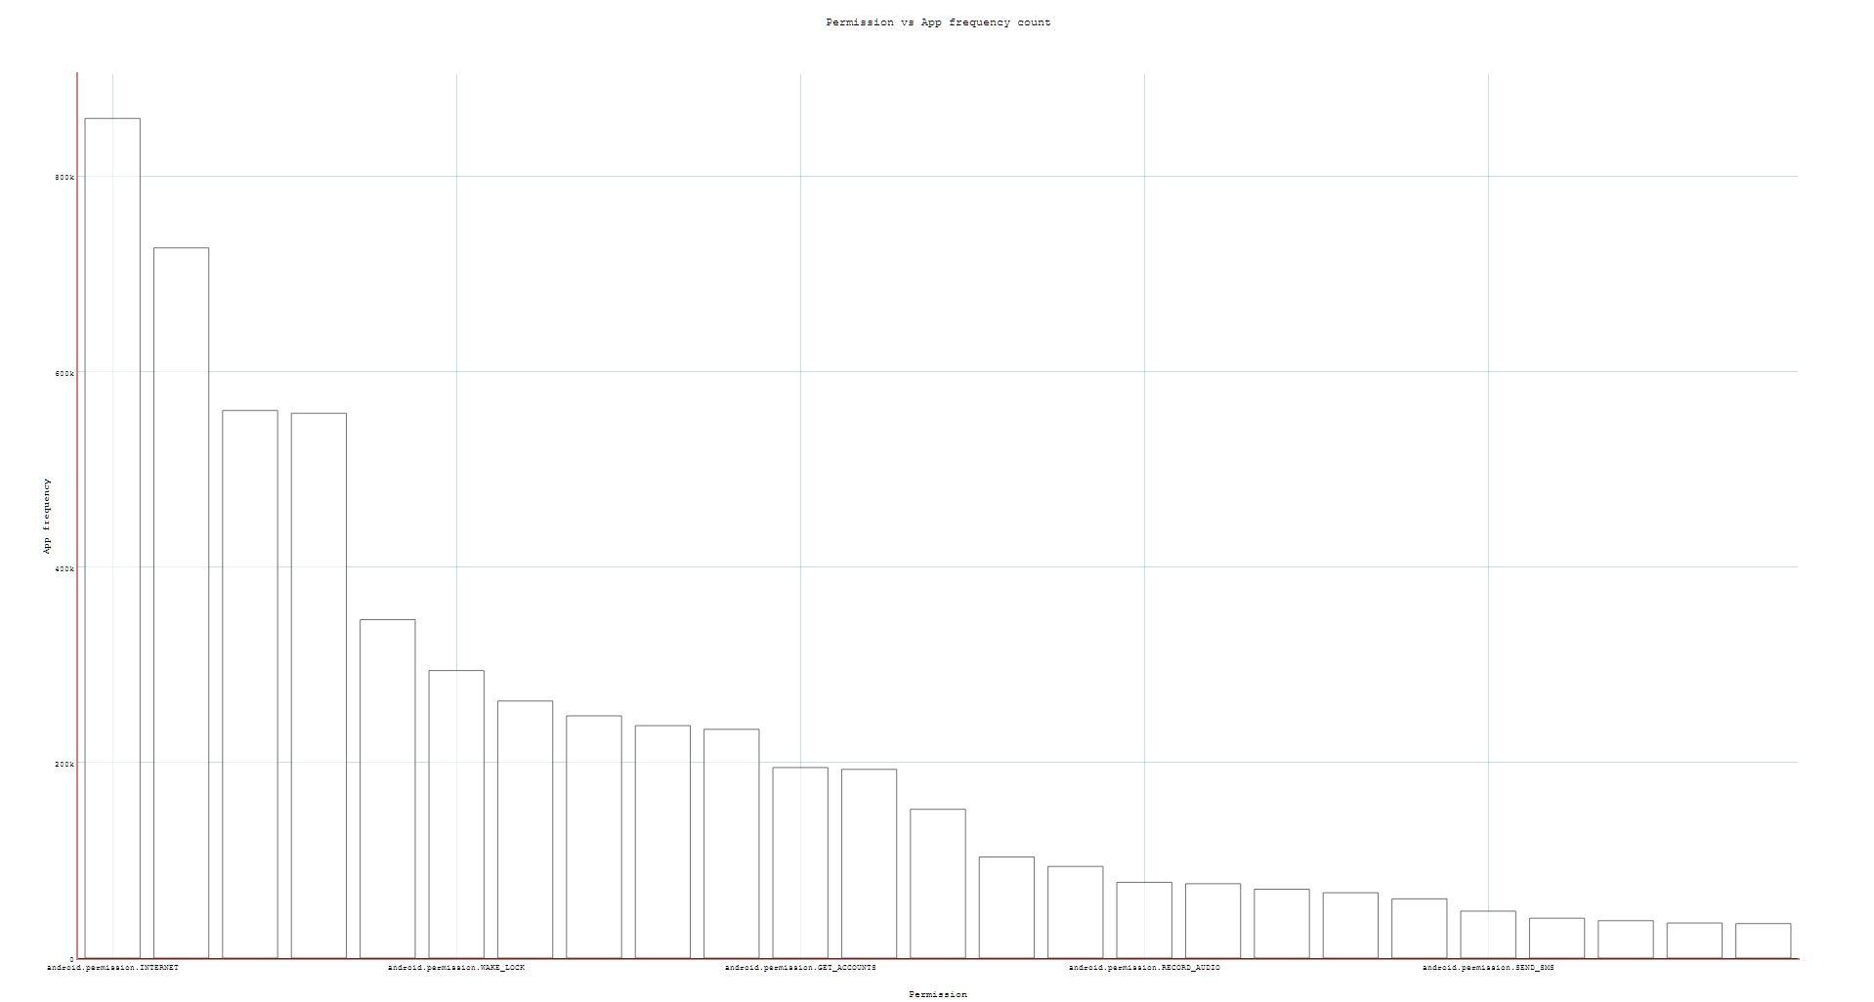
Top requested permissions
App Count | Permission Name
859199 | android.permission.INTERNET
726725 | android.permission.ACCESS_NETWORK_STATE
560329 | android.permission.READ_EXTERNAL_STORAGE
557428 | android.permission.WRITE_EXTERNAL_STORAGE
346285 | android.permission.READ_PHONE_STATE
294205 | android.permission.WAKE_LOCK
263031 | android.permission.ACCESS_FINE_LOCATION
247873 | android.permission.ACCESS_WIFI_STATE
237815 | android.permission.ACCESS_COARSE_LOCATION
234052 | android.permission.VIBRATE
194944 | android.permission.GET_ACCOUNTS
193073 | com.google.android.c2dm.permission.RECEIVE
152209 | android.permission.CAMERA
103478 | android.permission.CALL_PHONE
93749 | android.permission.RECEIVE_BOOT_COMPLETED
77515 | android.permission.RECORD_AUDIO
76072 | com.android.vending.BILLING
70459 | com.google.android.providers.gsf.permission.READ_GSERVICES
66856 | android.permission.READ_CONTACTS
60587 | android.permission.GET_TASKS
48008 | android.permission.SEND_SMS
40795 | com.android.vending.CHECK_LICENSE
38237 | android.permission.READ_CALL_LOG
35931 | android.permission.ACCESS_LOCATION_EXTRA_COMMANDS
35250 | android.permission.WRITE_CONTACTS

Slide 8
Algorithm working on
Transform an app to a vector rep by denoting which permission it is requesting
Technique 1: Use vector as an input to k-means clustering – Does app category become evident?
Technique 2: Select a category and using app permission vector try to detect outlier apps
Technique 3:
For apps requesting a bunch of unique permissions, extract app description
Can semantic similarity help in matching descriptions to permissions

Slide 9
Cluster evaluation
K-Means cluster evaluation measures:
Homogeneity Score: A clustering result satisfies homogeneity if all of its clusters contain only data points which are members of a single class.
Completeness Score: A clustering result satisfies completeness if all the data points that are members of a given class are elements of the same cluster.
Working on other measures and K-Medoid

Slide 10
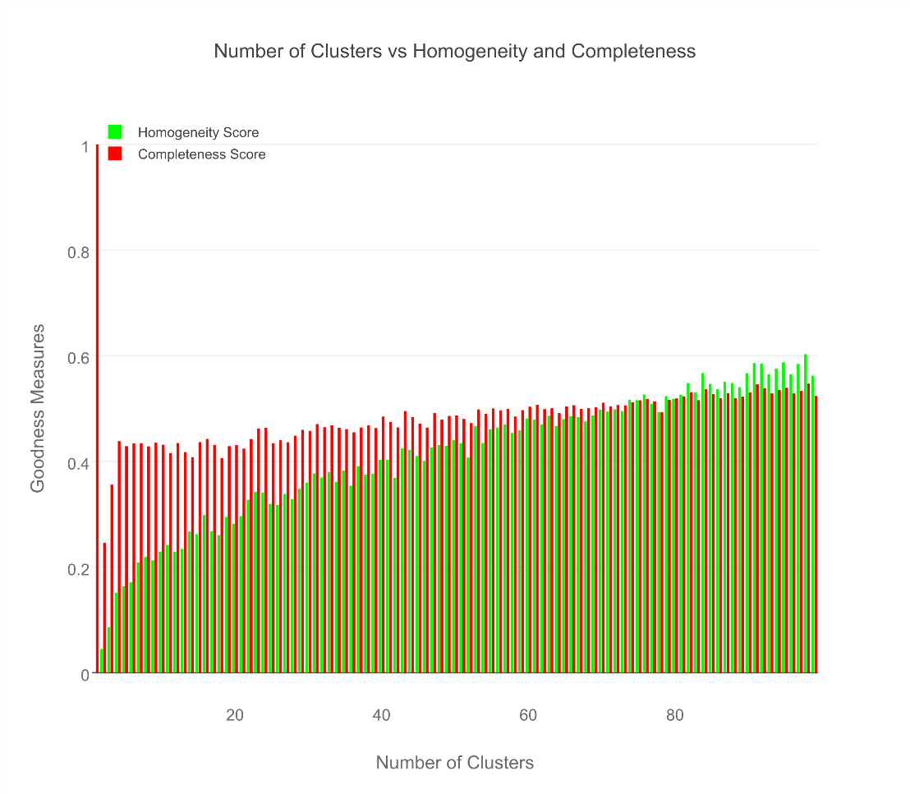
Cluster evaluation - KMeans

Slide 11
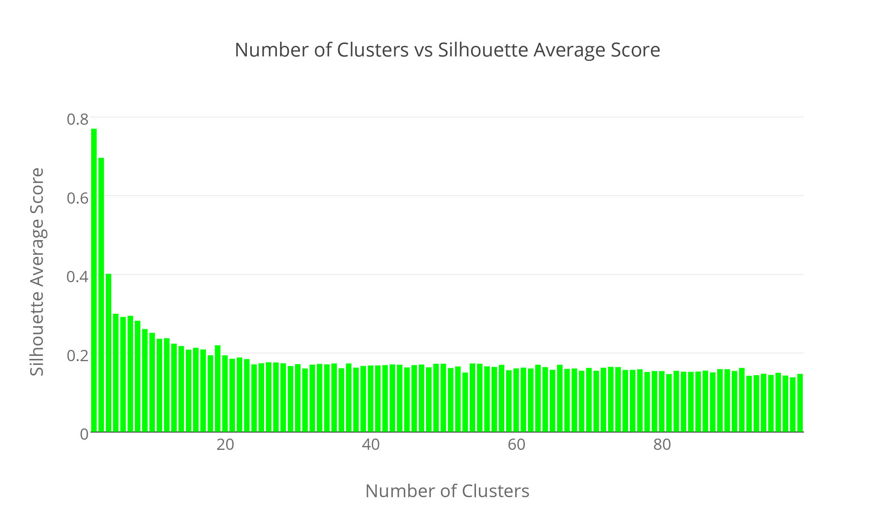
Clustering is not the right way? - KMeans

Slide 12
Manhattan distance - KMeans

Slide 13
Results for Medical & Healthcare Apps
AppPkgName | Cluster Assignment | AppCategory
com.fitnow.loseit | 13 | Health & Fitness
com.webmd.android | 13 | Health & Fitness
com.drugscom.app | 13 | Medical
com.ovuline.pregnancy | 13 | Medical
air.com.peppapig.paintbox | 13 | Educational
com.t11.skyviewfree | 13 | Education
gov.nasa | 13 | Education
com.google.android.stardroid | 13 | Books & Reference
com.turner.cnvideoapp | 13 | Media & Video
com.nextradioapp.nextradio | 13 | Music & Audio
com.camerasideas.instashot | 13 | Photography
com.foxsports.videogo | 13 | Sports
com.theopen | 13 | Sports
com.tregware.radar | 13 | Weather

Slide 14
Results for All Medical Apps
AppPkgName | Cluster Assignment | AppCategory
com.drugscom.app | 13 | Medical
com.ovuline.pregnancy | 13 | Medical
com.jardogs.fmhmobile | 14 | Medical
com.goodrx | 49 | Medical
com.microphone.earspy | 65 | Medical
com.hp.pregnancy.lite | 75 | Medical
com.carezone.caredroid.careapp.medications | 80 | Medical
com.smsrobot.period | 94 | Medical
epic.mychart.android | 96 | Medical

Slide 15
Results for All Health & Fitness Apps
AppPkgName | Cluster Assignment | AppCategory
com.fitnow.loseit | 13 | Health & Fitness
com.webmd.android | 13 | Health & Fitness
com.period.tracker.lite | 27 | Health & Fitness
com.popularapp.periodcalendar | 27 | Health & Fitness
com.cvs.launchers.cvs | 32 | Health & Fitness
com.babycenter.pregnancytracker | 54 | Health & Fitness
com.fitbit.FitbitMobile | 60 | Health & Fitness
com.myfitnesspal.android | 87 | Health & Fitness
com.google.android.apps.fitness | 91 | Health & Fitness
com.tayu.tau.pedometer | 94 | Health & Fitness

Slide 16
Library Apps seem like the best
AppPkgName | Cluster Assignment | AppCategory
com.aviary.android.feather.plugins.borders.free | 5 | Libraries & Demo
com.aviary.android.feather.plugins.filters.original | 5 | Libraries & Demo
com.aviary.android.feather.plugins.stickers.free_stickers | 5 | Libraries & Demo
com.estrongs.chromecast | 5 | Libraries & Demo
com.foxfi.addon | 5 | Libraries & Demo
com.mxtech.ffmpeg.v7_neon | 5 | Libraries & Demo
com.mxtech.ffmpeg.v7_vfpv3d16 | 5 | Libraries & Demo
com.google.samples.apps.cardboarddemo | 27 | Libraries & Demo
com.google.vr.cardboard.apps.designlab | 27 | Libraries & Demo
com.ivona.tts | 65 | Libraries & Demo

Slide 17
Finance apps seem to pretty uniform
AppPkgName | Cluster Assignment | AppCategory
com.google.android.apps.walletnfcrel | 31 | Finance
com.infonow.bofa | 31 | Finance
com.paypal.android.p2pmobile | 31 | Finance
com.geico.mobile | 32 | Finance
com.creditkarma.mobile | 57 | Finance
com.acorns.android | 58 | Finance
com.chase.sig.android | 58 | Finance
com.venmo | 58 | Finance
com.wf.wellsfargomobile | 58 | Finance

Slide 18
What did we see in cluster 5?
read phone status and identity, full network access
read sensitive log data, full network access
find accounts on the device, control vibration, run at startup, read Google service configuration, full network access
modify or delete the contents of your USB storage, read the contents of your USB storage, Wi-Fi connection information, view Wi-Fi connections, Google Play license check, full network access, prevent device from sleeping, view network connections
precise location (GPS and network-based), draw over other apps

Slide 19
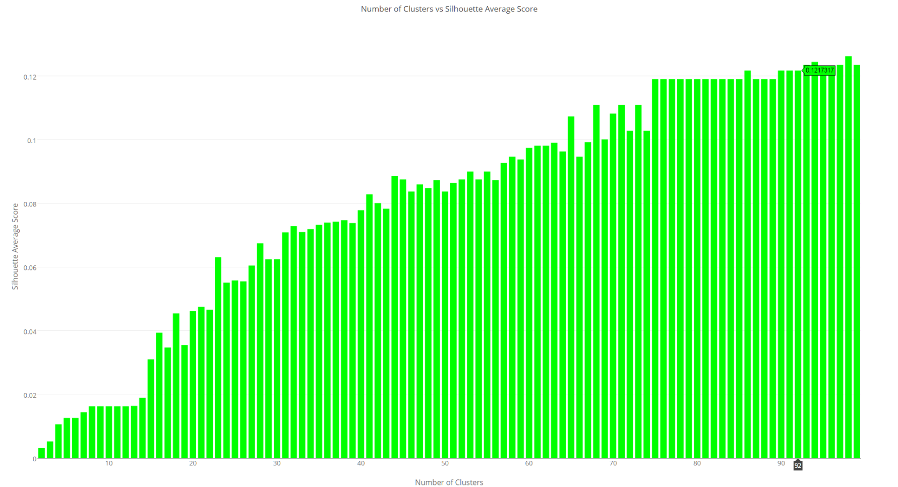
Weighted Jaccard Similarity – Spectral Clustering, True Value comparison

Slide 20
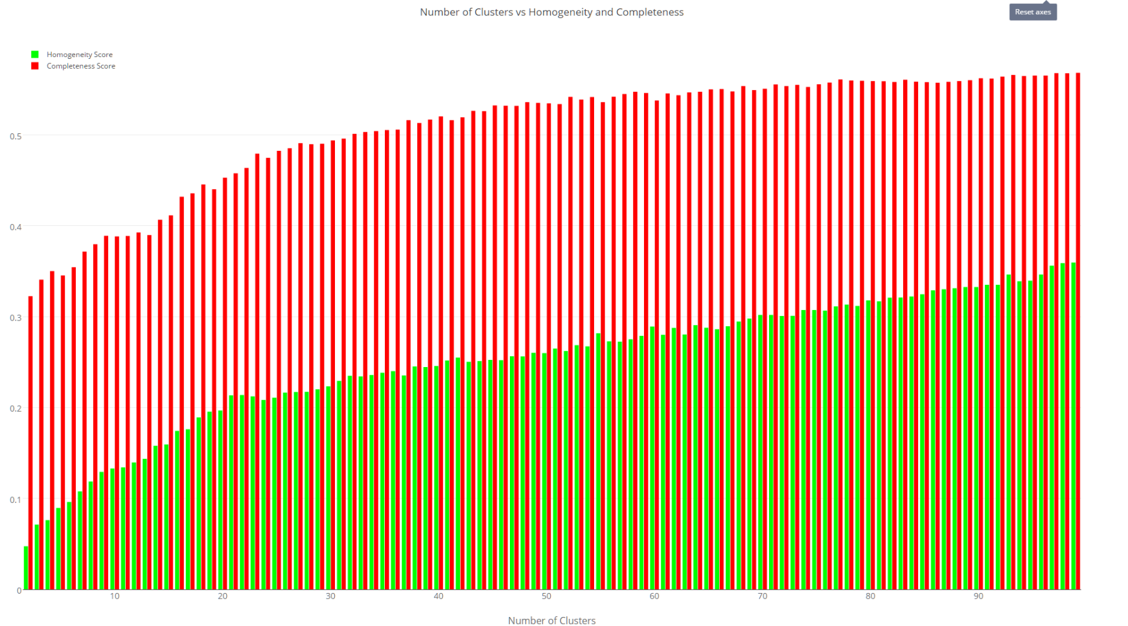
Weighted Jaccard Similarity – Spectral Clustering, Silhouette Measures

